Slide 1


Slide 2
Hack Together: RAG Hack
aka.ms/RAGhack
Week 1: September 3 - 8
9
MONDAY
3
TUESDAY
4
WEDNESDAY
5
THURSDAY
6
FRIDAY
7
SATURDAY
8
SUNDAY
RAG 101
.NET
Azure AI Studio
Python
Langchain4J
LangchainJS
Responsible AI
MongoDB
Azure AI Search
PostgreSQL
Azure SQL
GraphRAG
Multi-channels
Hack!
Hack!
Hack!
Hack!
Hack!
Hack!
Week 2: September 9 - 14
9
MONDAY
10
TUESDAY
11
WEDNESDAY
12
THURSDAY
13
FRIDAY
14
SATURDAY
15
SUNDAY
Semantic Kernel
Spring AI
Vision models
Internationalization
VSCode Agent
Agentic RAG
Code Interpreter
AI Studio Advanced
AutoGen
Data Access Control
Fine Tuning
Model catalog
Evaluations
Hack!
Hack!
Hack!
Hack!
Hack!
Hack!
Hack!
Hack!
Hack!
Submissions due September 16, 11:59 PM PT!

Slide 3
Use Phi-3 to create a VSCode chat agent extension
Kinfey Lo
Senior Cloud Advocate
github.com/kinfey

Slide 4
Agenda
What is Phi-3
How to use Phi-3
Introduce GitHub Copilot Chat Workspace
DEMO
Create Custom VSCode Git Copilot Agent

Slide 5
What is Phi-3 / 3.5

Slide 6
Introduce Microsoft Phi-3
The 3.8B language model is available on Microsoft Azure AI Studio, Hugging Face, and Ollama. Phi-3 models significantly outperform language models of equal and larger sizes on key benchmarks (see benchmark numbers below, higher numbers are better). Phi-3-mini outperforms models twice its size, while Phi-3-small and Phi-3-medium outperform larger models, including GPT-3.5
Phi-3-mini
With just 7B parameters, Phi-3-small beats GPT-3.5T on a variety of language, reasoning, coding, and math benchmarks.
The Phi-3-medium with 14B parameters continues this trend and outperforms the Gemini 1.0 Pro.
Phi-3-small & medium
Phi-3-vision, with only 4.2B parameters, continues this trend and outperforms larger models such as Claude-3 Haiku and Gemini 1.0 Pro V on general visual reasoning tasks, OCR, and table and diagram comprehension tasks.
Phi-3-Vision

Slide 7
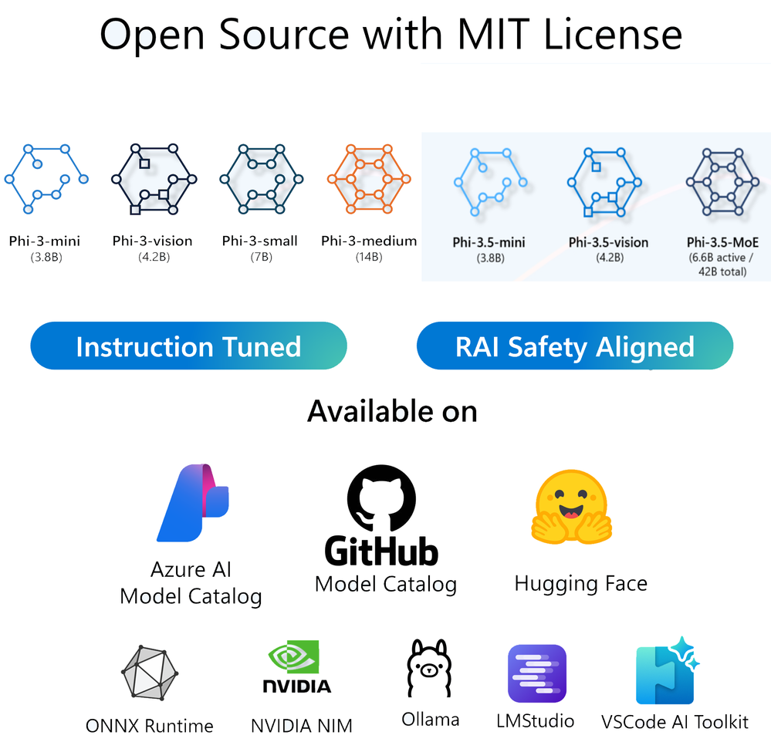
Microsoft Phi Family are growing

Slide 8




Phi-3: Breakthrough SLM Performance
Quality
Best price/performance ratio for size; outperforms models 2x larger
Runs everywhere
CPU and GPU; Cloud and on-device
Speed
Extremely fast speed
Long-context
Send more context in the prompt

Slide 9
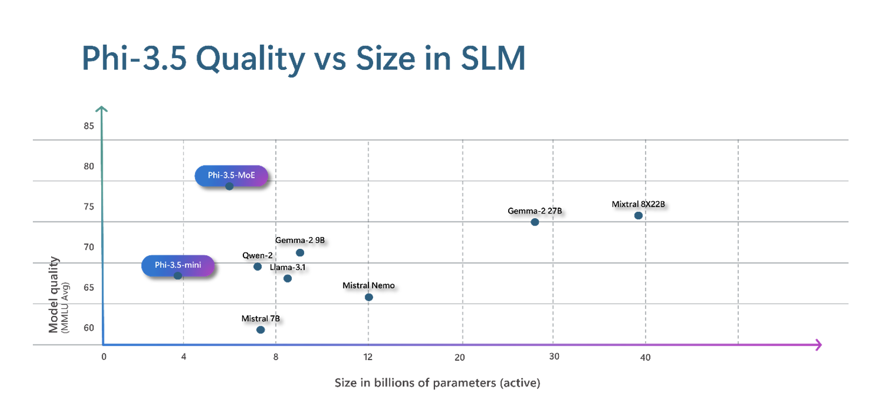
Phi Small size, high quality

Slide 10
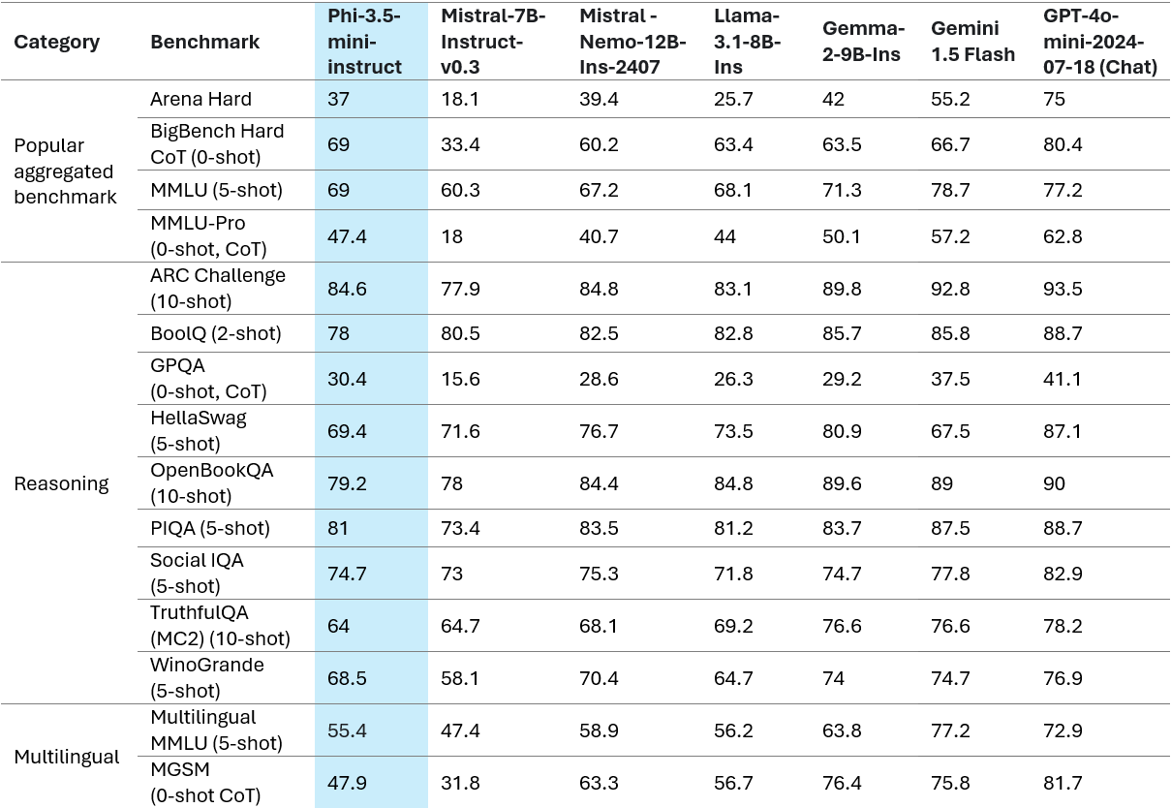
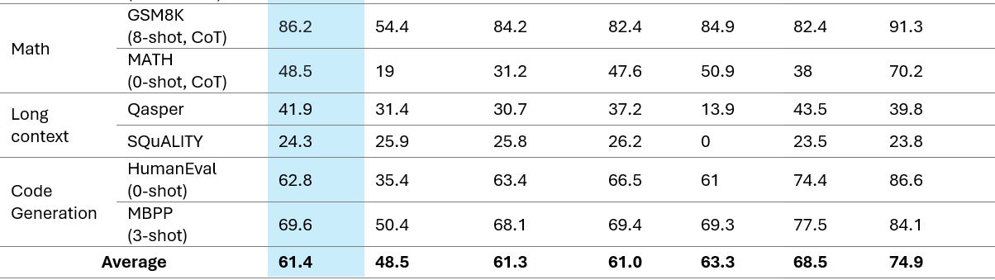
Phi-3.5-mini’s groundbreaking performance Phi-3.5-mini significantly outperforms language models of the same size and larger
Phi-3.5-mini with 3.8B parameters outperforms language models of the same size and on par with models twice its size
Support 20+ languages:
Arabic, Chinese, Czech, Danish, Dutch, English, Finnish, French, German, Hebrew, Hungarian, Italian, Japanese, Korean, Norwegian, Polish, Portuguese, Russian, Spanish, Swedish, Thai, Turkish, Ukrainian

Slide 11
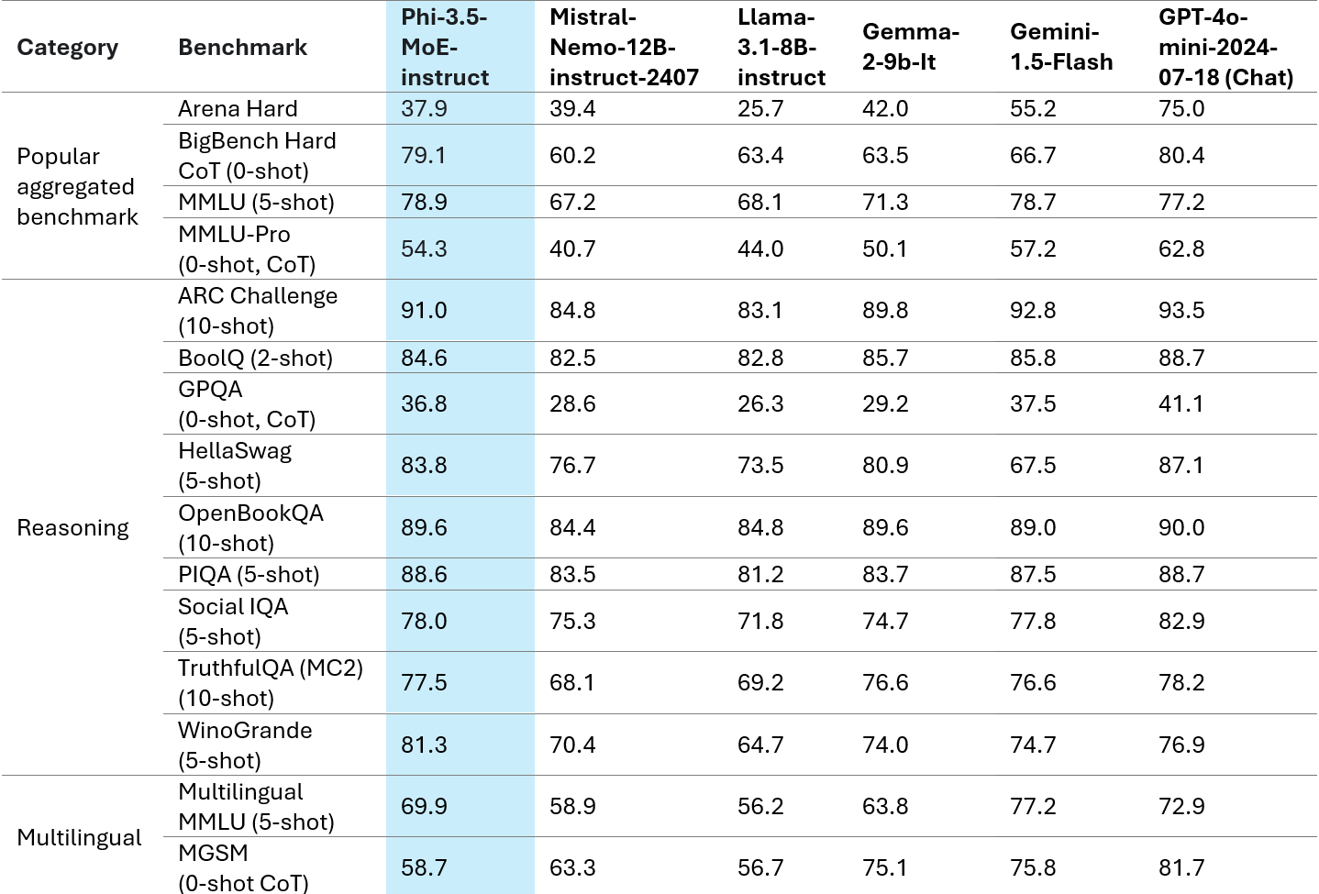
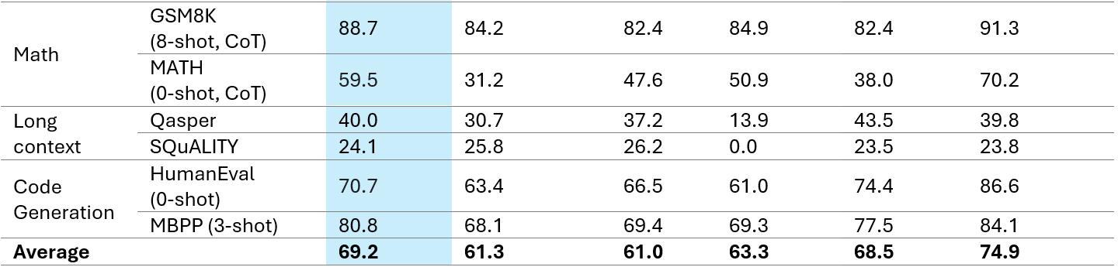
Phi-3.5-MoE’s groundbreaking performance Phi-3-MoE significantly outperforms language models of the same size and larger
Phi-3.5-MoE comprises 16x3.8B expert modules
Phi-3.5-MoE with only 6.6B active parameters achieves a similar level of reasoning, language understanding, and math as much larger models
Support 20+ languages:
Arabic, Chinese, Czech, Danish, Dutch, English, Finnish, French, German, Hebrew, Hungarian, Italian, Japanese, Korean, Norwegian, Polish, Portuguese, Russian, Spanish, Swedish, Thai, Turkish, Ukrainian

Slide 12
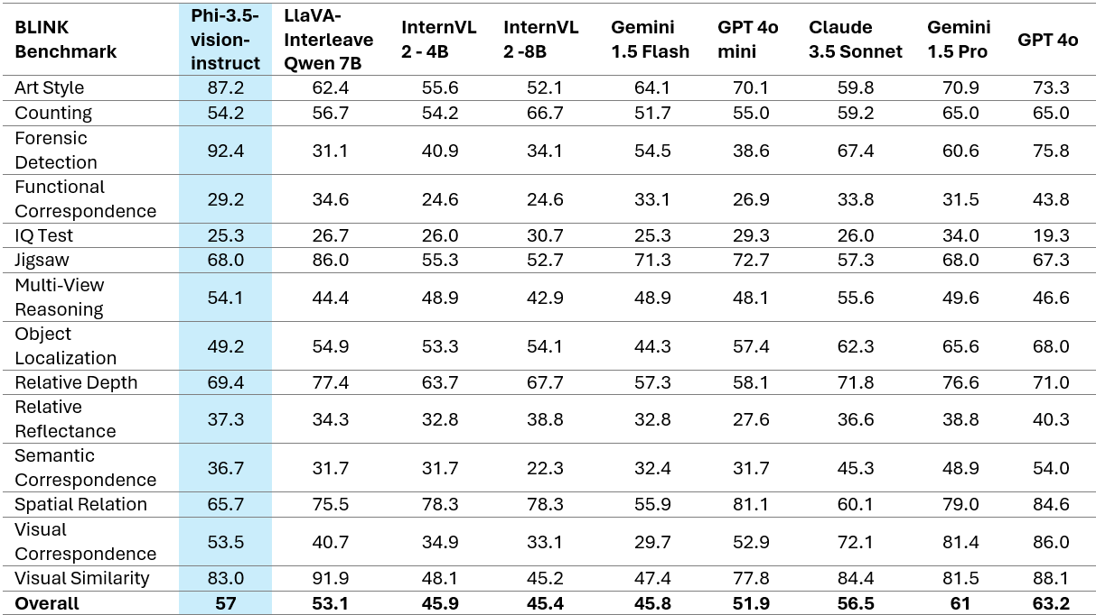
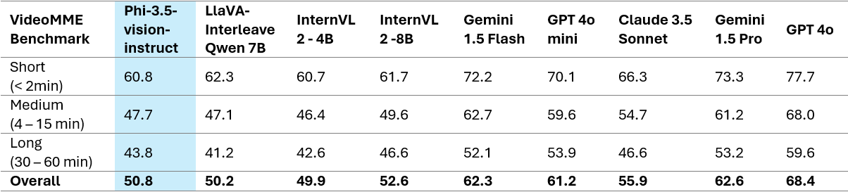
Phi-3.5-vision’s groundbreaking performance Phi-3.5-vision significantly outperform language models of the same size and larger
Phi-3.5-vision outperforms larger models such as Claude-3.5 Sonnet and Gemini 1.5 Flash across OCR, table and chart understanding tasks and on par on general visual knowledge reasoning tasks.
Support multi-frame input, i.e., perform reasoning on multiple input images

Slide 13
How to use Phi-3 / 3.5

Slide 14
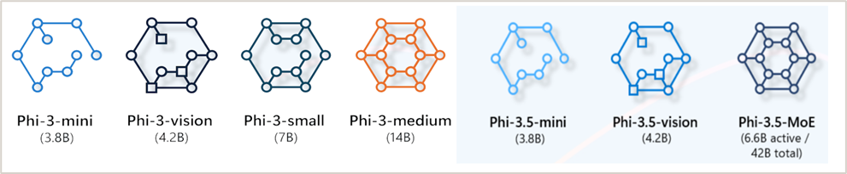
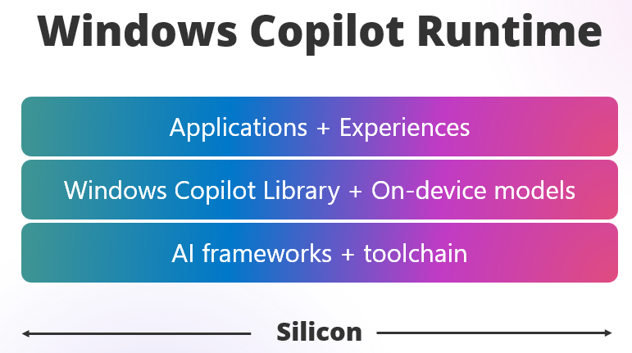





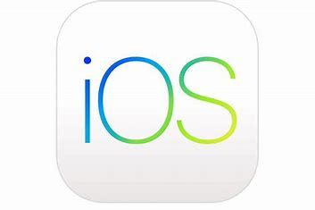


Opportunities for SLM applications and devices
Small Language Models
On Cloud
On Edge
Mobile • Edge
(iOS, Android)
aka.ms/wcr

Slide 15
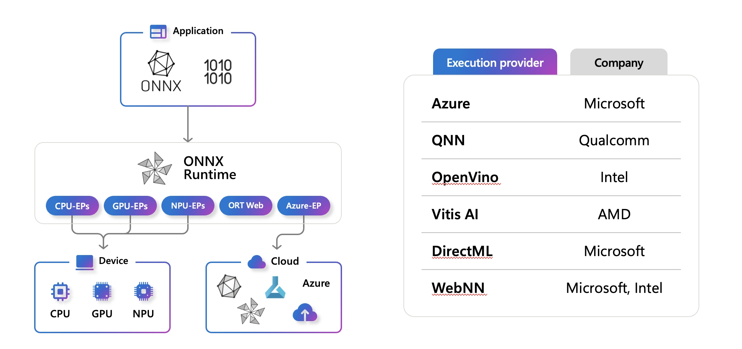
Optimizing and performing ONNX runtime

Slide 16
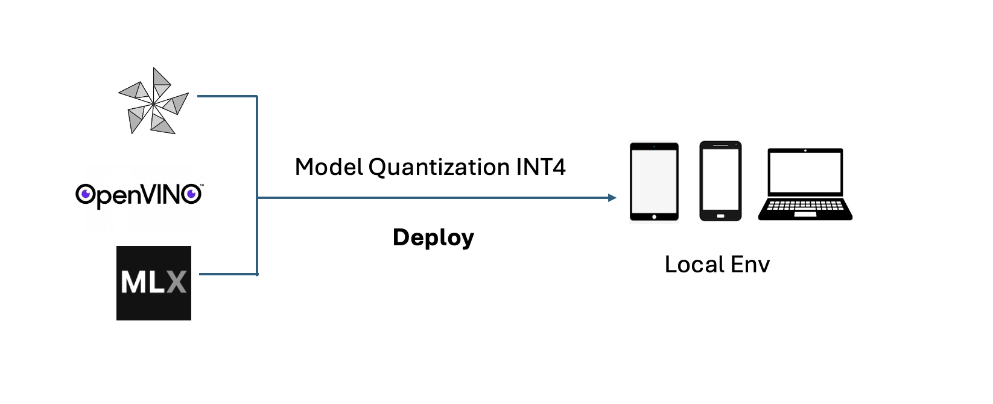
Running Phi-3 in Any Devices

Slide 17
DEMO

Slide 18
GitHub Copilot Chat Workspsace

Slide 19
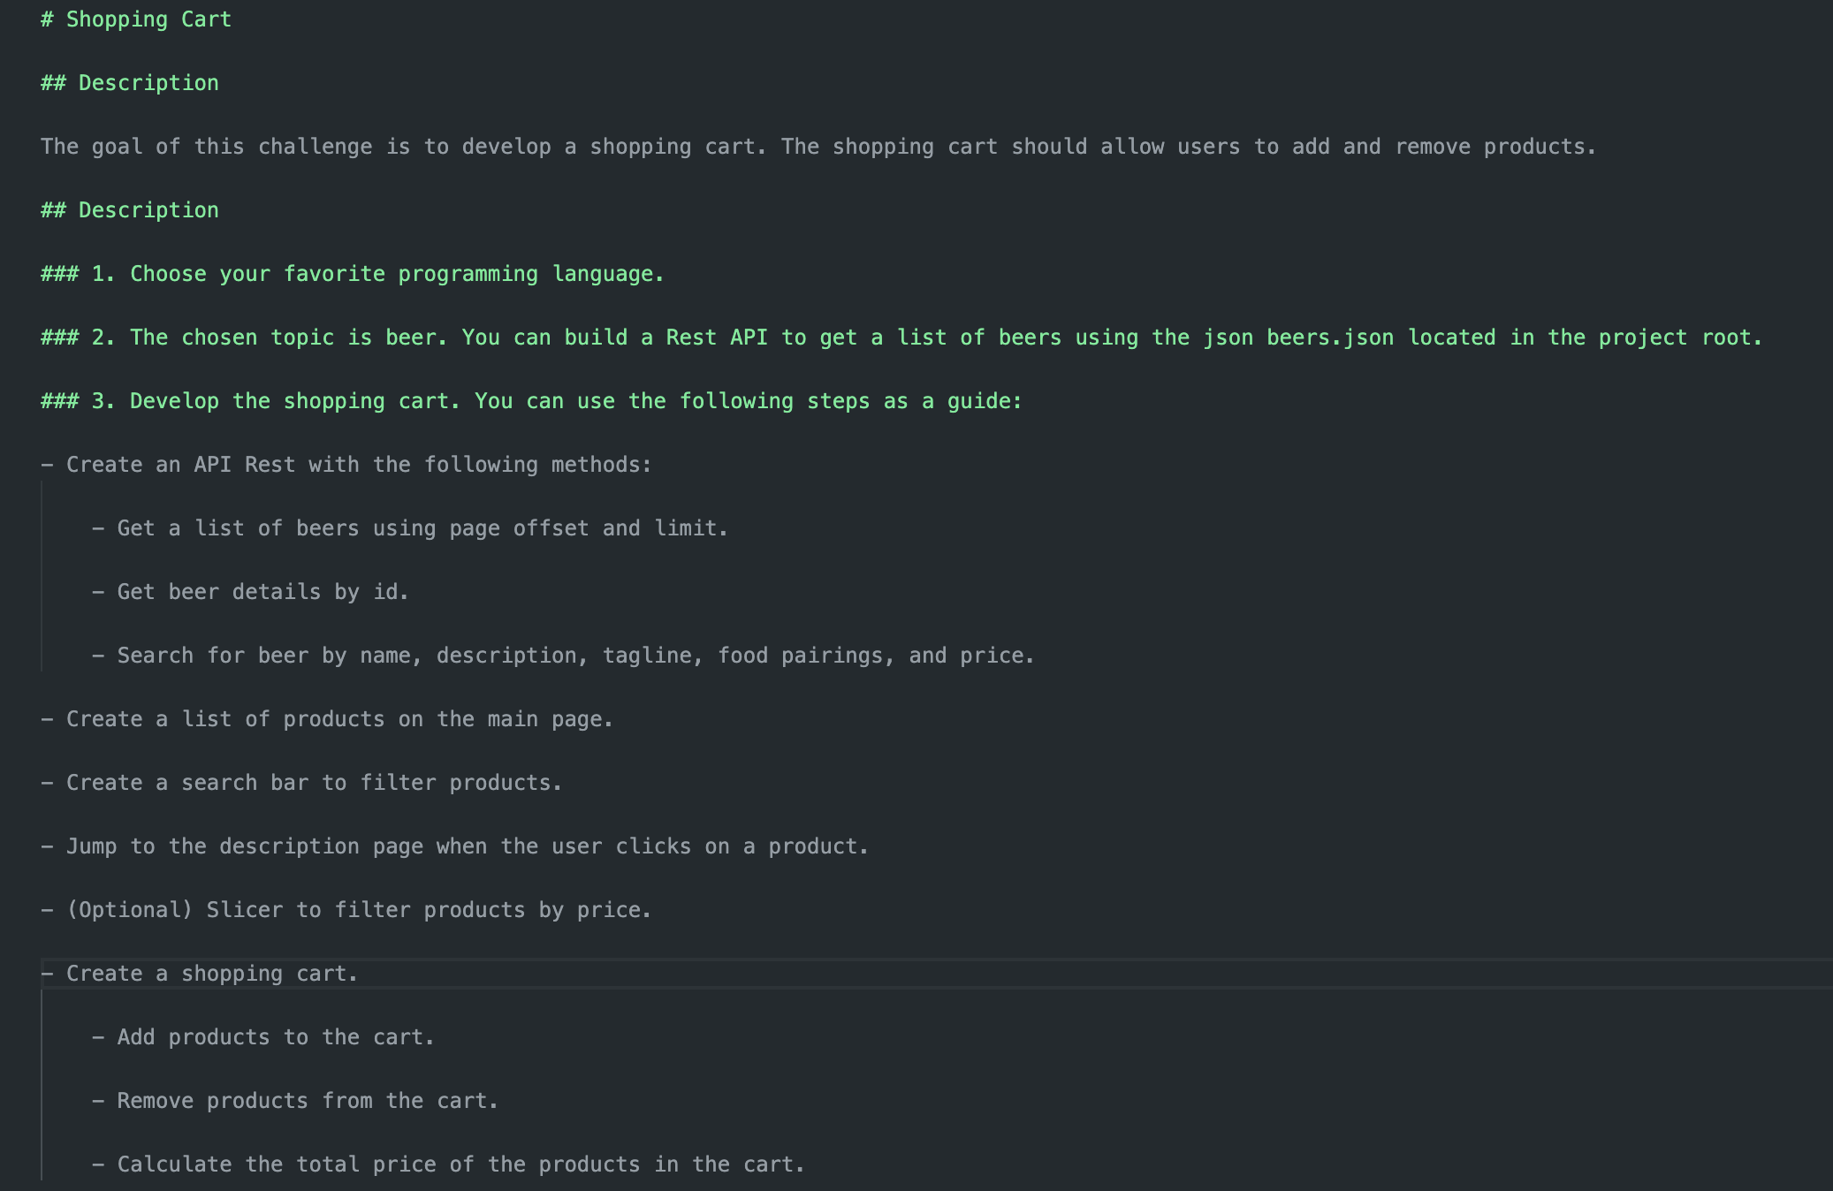
How to create a project

Slide 20
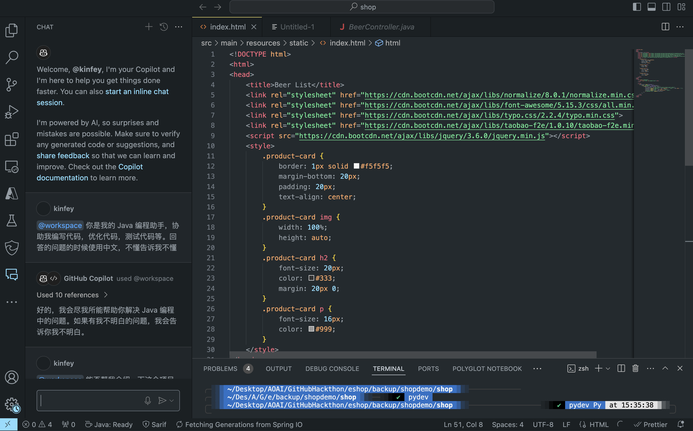
Chat with Project

Slide 21
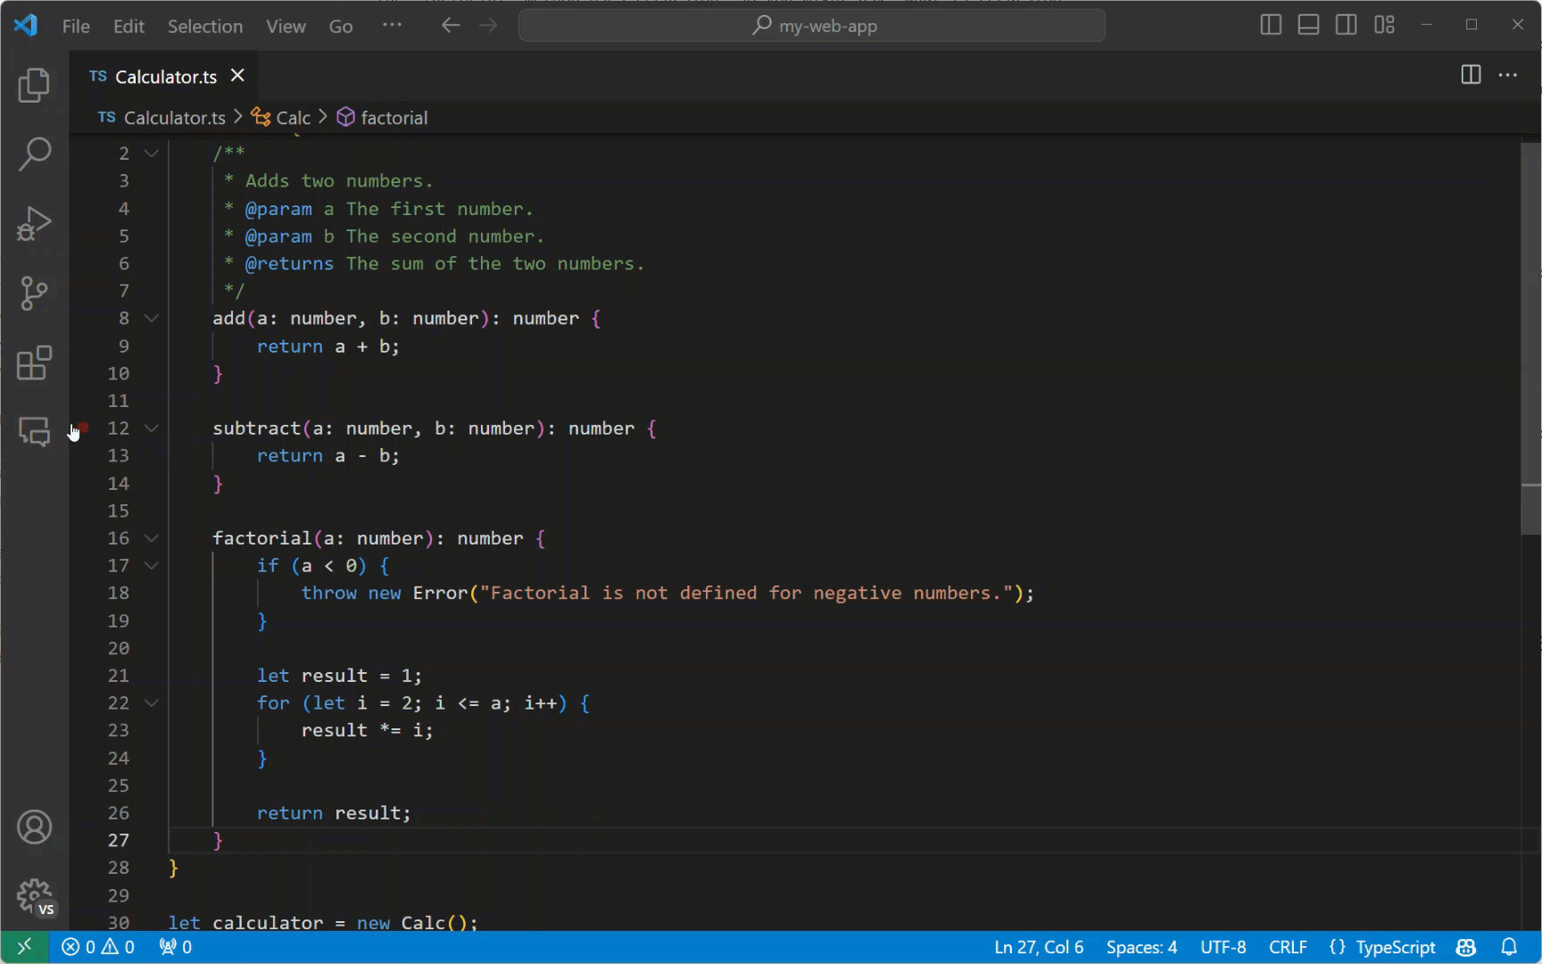
GitHub Copilot Agent
@terminal @vscode @workspace

Slide 22
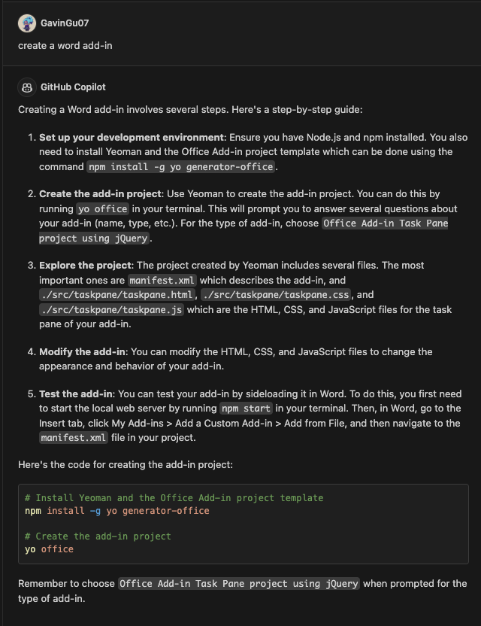
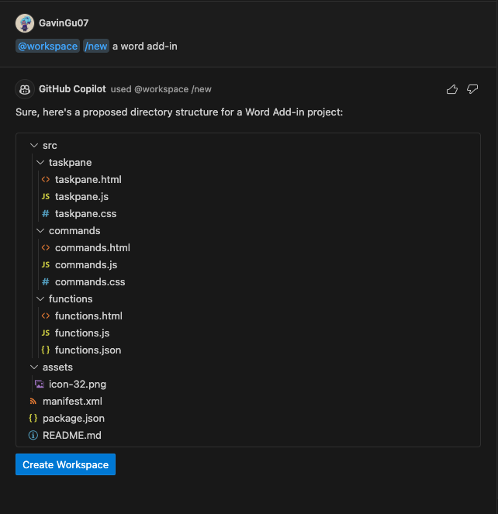
DEMO

Slide 23
Create GitHub Copilot Chat Agent

Slide 24
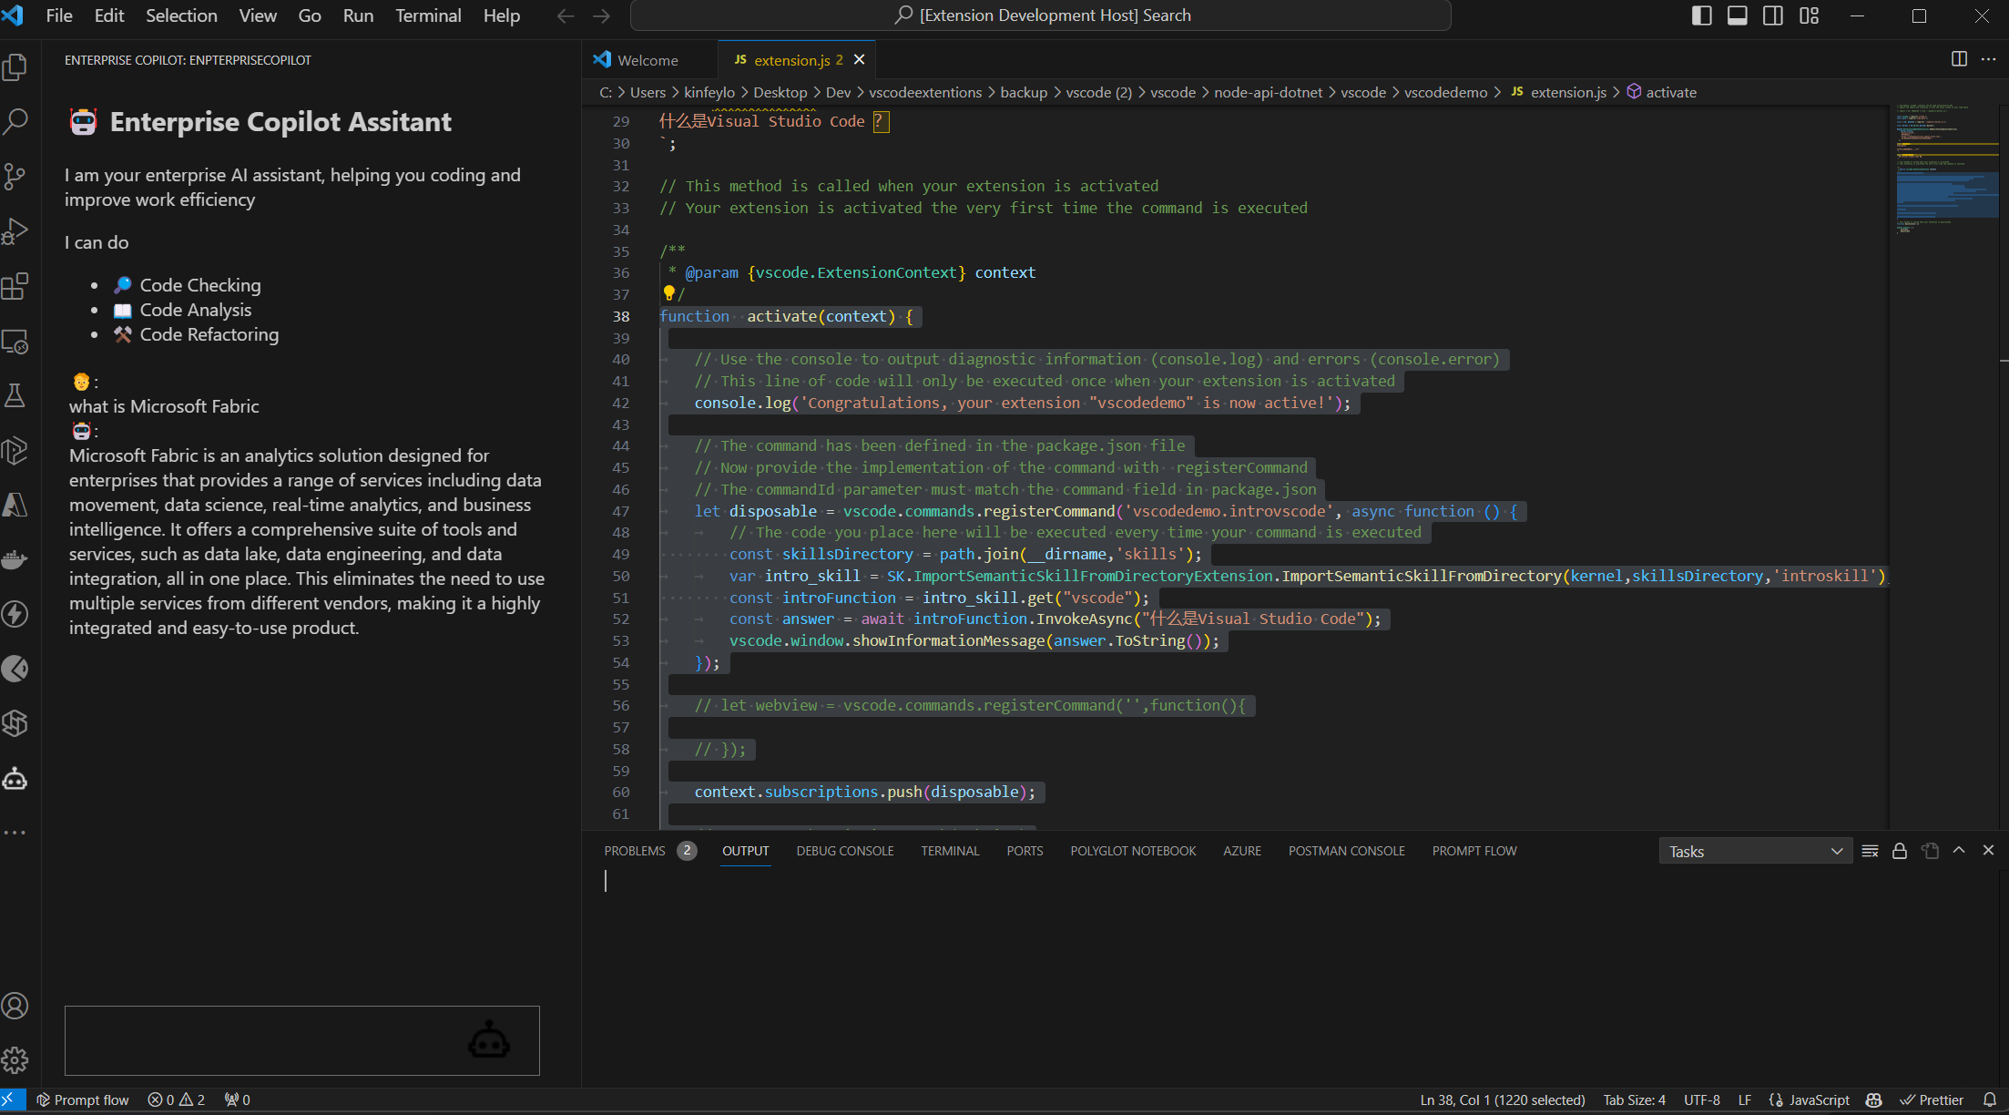
Enterprises need their own development tools

Slide 25

Fine-tuning Code LLMs/SLMs

Slide 26

The Importance of a Unified Experience

Slide 27
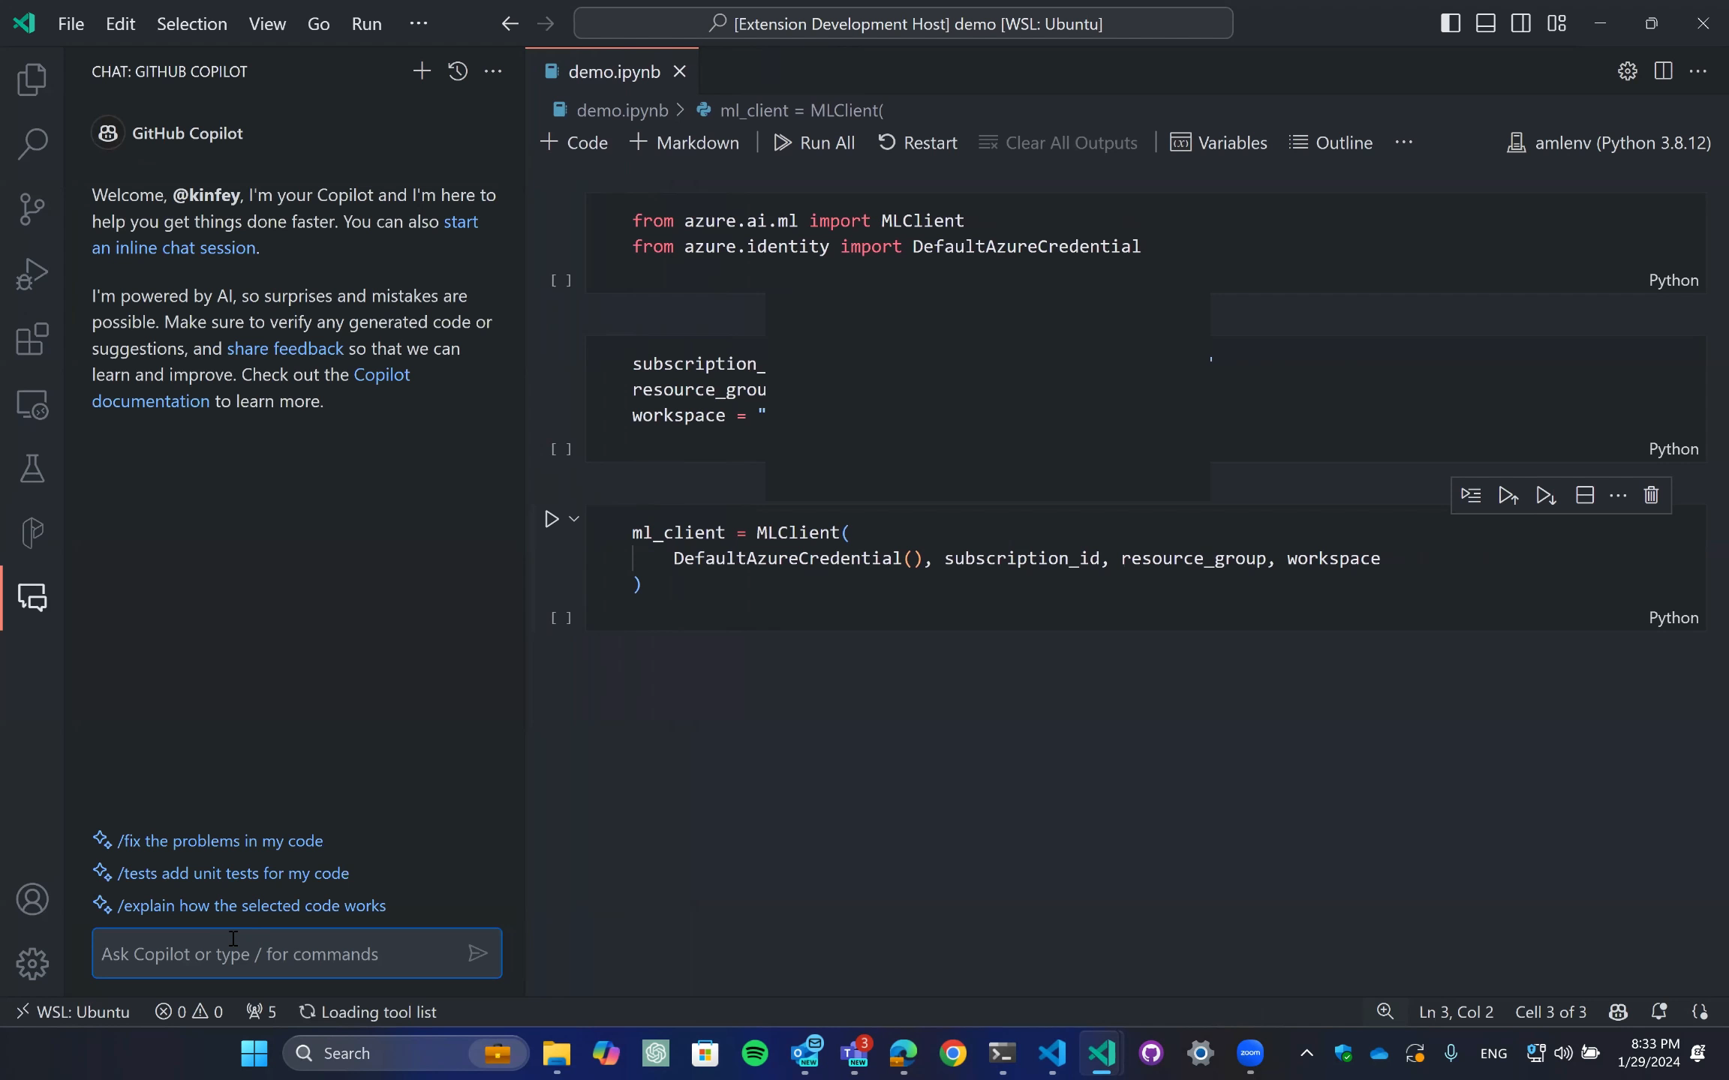

Slide 28
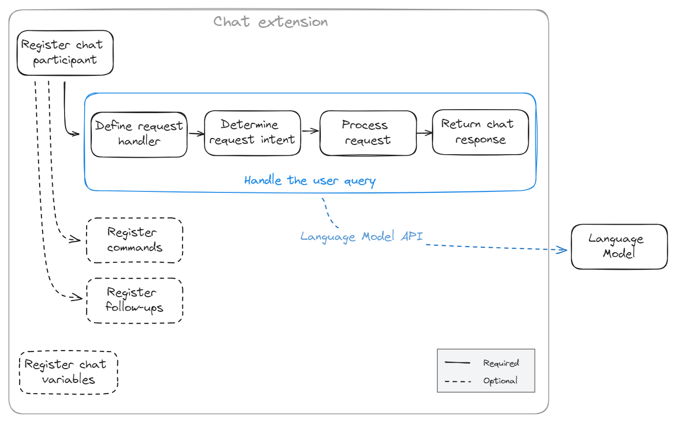
Samples – VSCode Ext + GitHub Model
https://code.visualstudio.com/api/extension-guides/chat

Slide 29
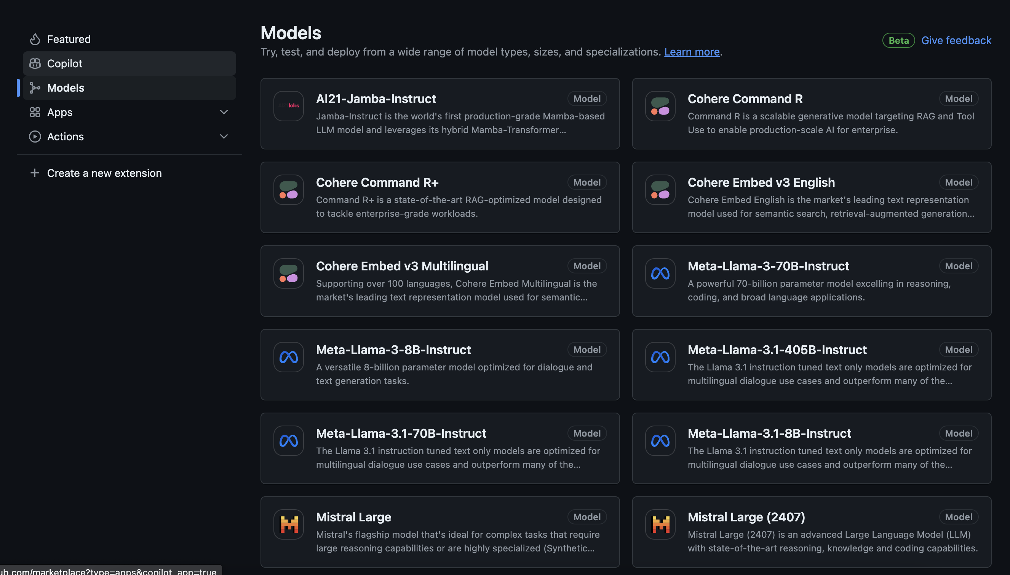
Models – GitHub Models

Slide 30
DEMO

Slide 31
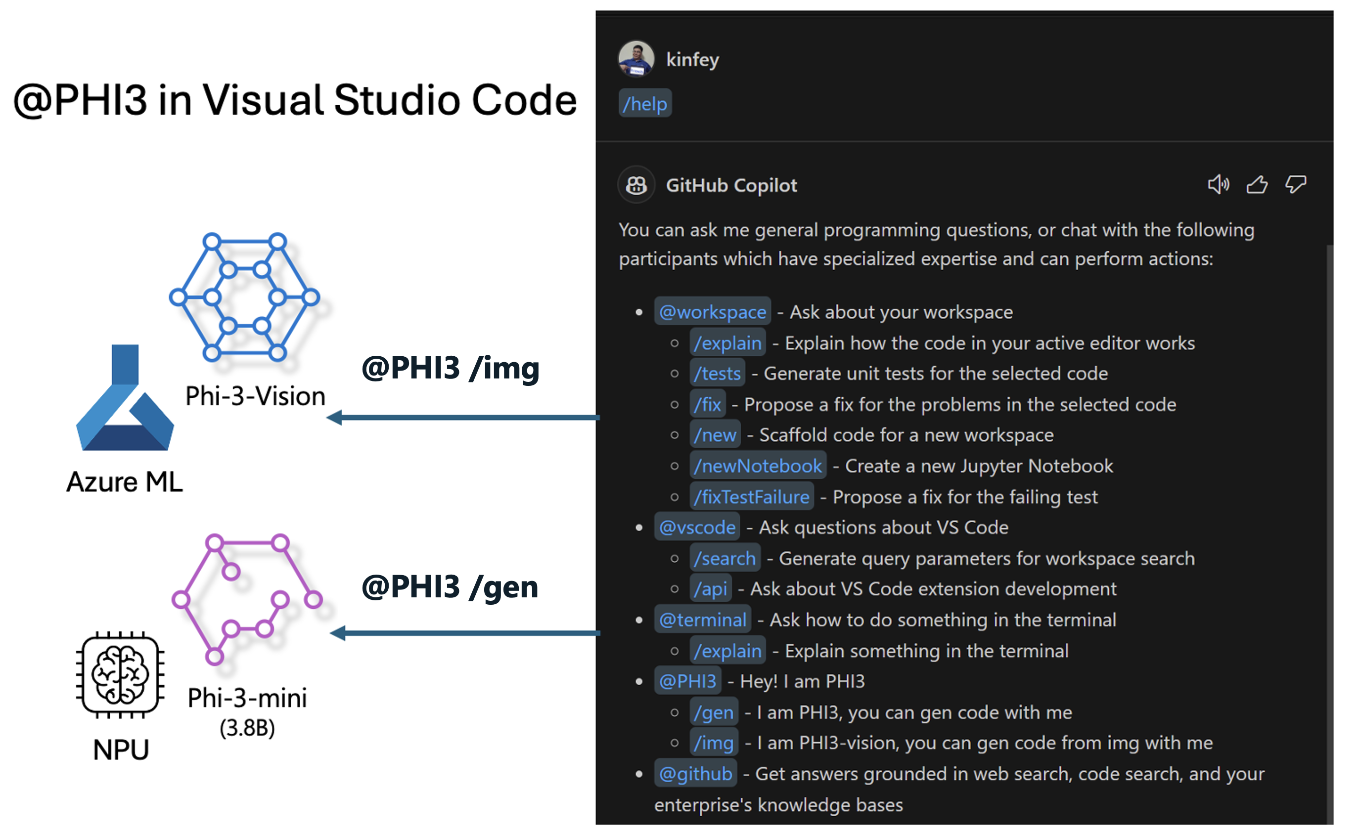
Running Local Model
https://github.com/microsoft/Phi-3CookBook/blob/main/md/07.Labs/VSCode/

Slide 32
Resources
Phi-3 Cookbook https://aka.ms/phi-3cookbook
Create Your First Extension · Visual Studio Code - The Essentials (microsoft.github.io)
Learn more about Visual Studio Code Chat API https://code.visualstudio.com/api/extension-guides/chat

Slide 33
RAGHack: Next steps
Register for the hackathon @ aka.ms/raghack/register
Hack, hack, hack! Try our code samples or start from scratch!🧑🏿‍💻 👩🏻‍💻 👩🏼‍💻
For any questions, post in GitHub forum or attend Discord Office Hours. 🙋🏼 🙋🏾‍♀️
Join more live RAG sessions! aka.ms/raghack/streams
Submit your project before September 16th 11:59 PM PT to win prizes! 💵

Slide 34
Thank you

